Slide 1
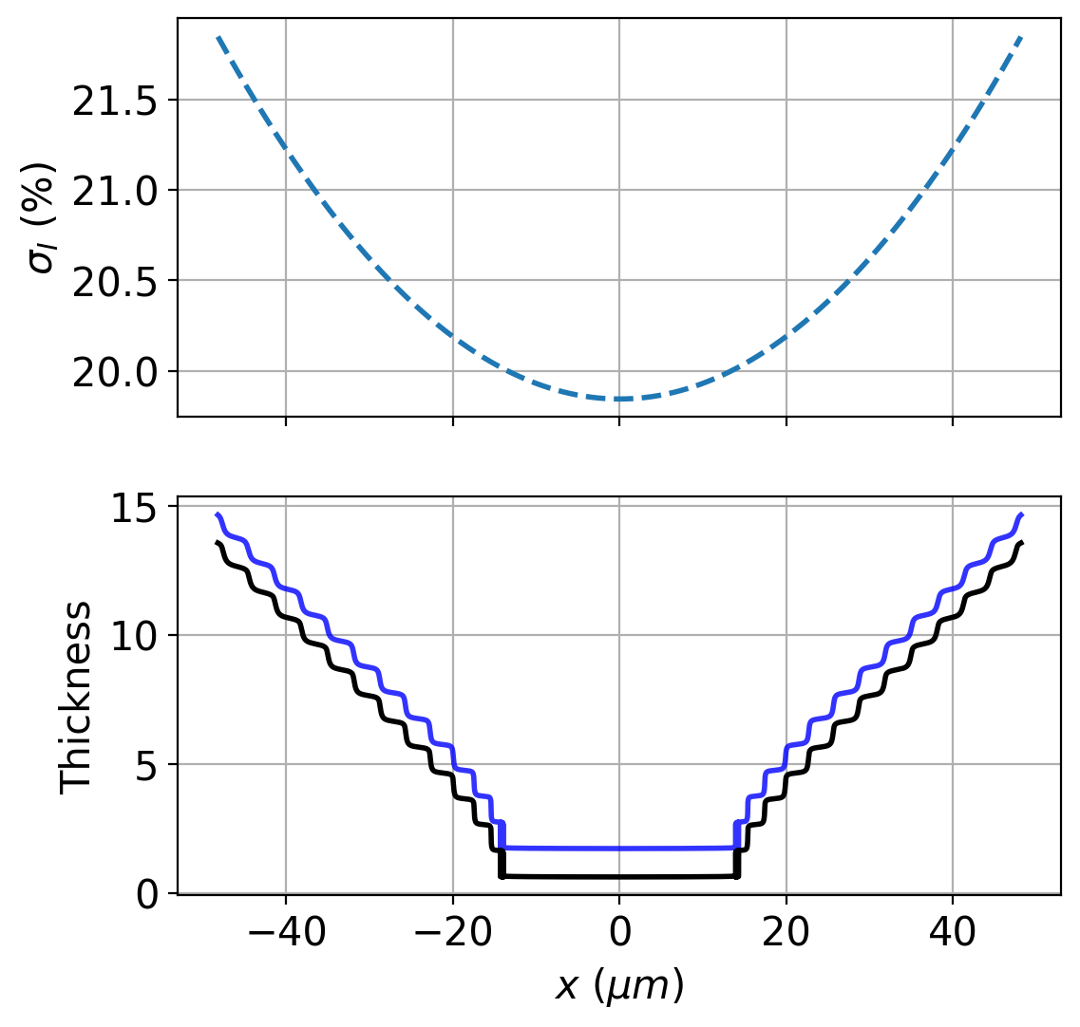
(a)
(b)

Slide 2
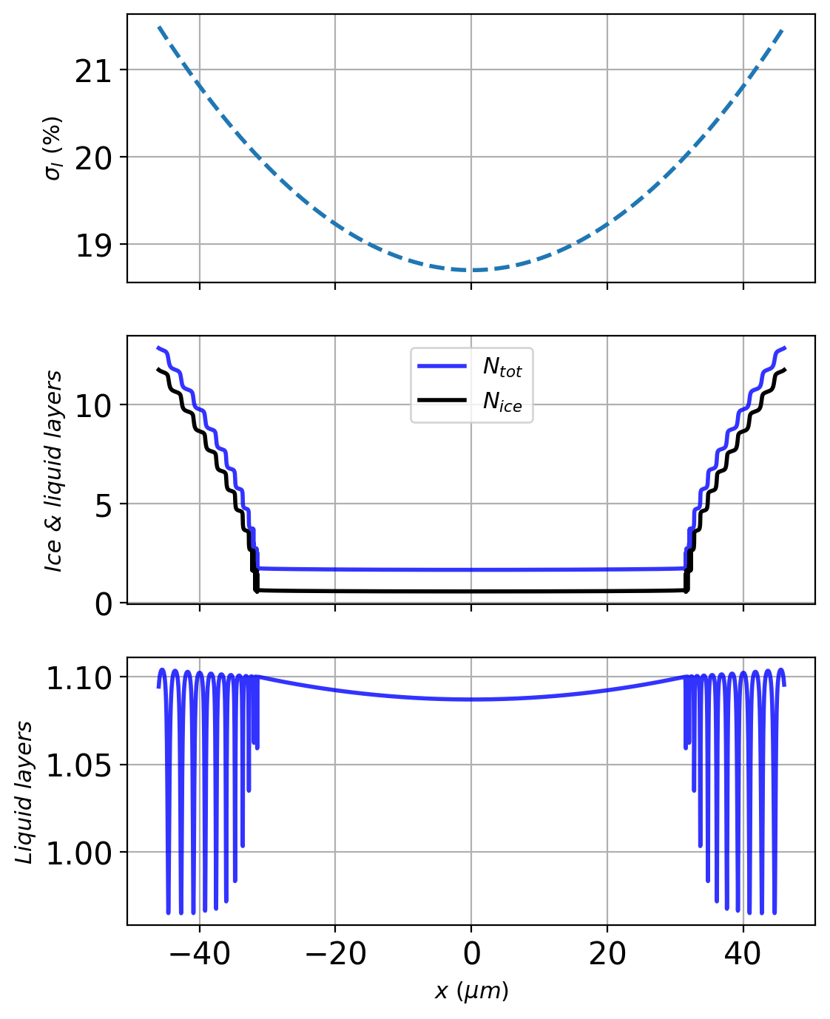
(a)
(b)
(c)

